Slide 1
Steganography Project
Pratheek, Andy and Harry

Slide 2
Contents
Aim of the project
Raspberry Pi and Java code
Explanation
Demonstration
Evaluation and Further Directions

Slide 3
Aim
Part 1
Low bit hiding/Bit wise operation
To Hide a Image
Reconstruction
Part 2
Raspberry Pi
Picture Capturing
Combine
Notes:
720p

Slide 4
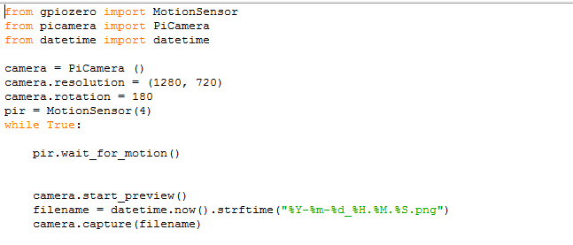
Raspberry Pi Code
Library for the code
Resolution
True statement for the picture
Notes:
First talk about the code
Without the libraries being imported from the raspberry Pi, the code would not work
(1280,720) is the resolution of the picture since we were tasked to use a 720p picture for hiding
The camera is rotated 180 degrees because originally the camera is set upside down.
The MotionSensor is connected to PIN number 4 in the GPIO settings
When the sensor detects motion, it tells the camera to take a picture and then save it with the year, month, date, hours, minutes.
It is saved as a .png file because .png is used to save high quality images
Then show everyone the circuit with all the components
Talk about the Raspberry Pi circuit
Camera attached to the connector in the Raspberry Pi (Normal camera attached)
Talk about how the MotionSensor and how to change sensitivity and time
Talk about GPIO pins
Show live demonstration of the code

Slide 5
Approaches
Steganography
Low Bit Hiding
Least significant bit
Randomizing
Encryption
File Linking
Encryption
+
File Linking
+
Least Significant Bit
Notes:
Well, as my teammate, Pratheek already showed you how we can capture the image by using the raspberry pi. Now, I'm going to talk about how we can hide a picture inside another picture. we found out some possible solutions which are . We decided to use encrytion. File linking and least sigficicant bit. My teammate, Andy will talk about least significant bit after this. Let begin with the encryption first

Slide 6
Encryption

Slide 7
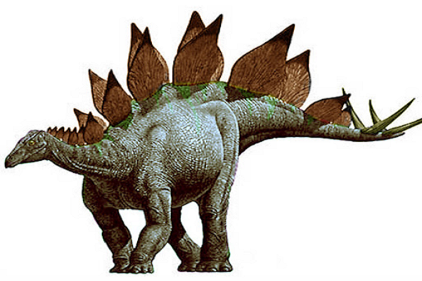
IMAGE STRUCTURE
File Signature
Image Header
Image Data
Image Footer
Notes:
Is there anyone wonder how the computer can show the images on the screen. There is no magic. The secret is the file structure. First, the computer will look at the file signature to know whether it a picture or a document file. Then, the computer will looking for the header and data, finally the footer. Basically, it kinda the same with a structure of a essay.
So, if mess up the image structure. So, the computers don’t know what that is. Neither me So how I can do that?

Slide 8
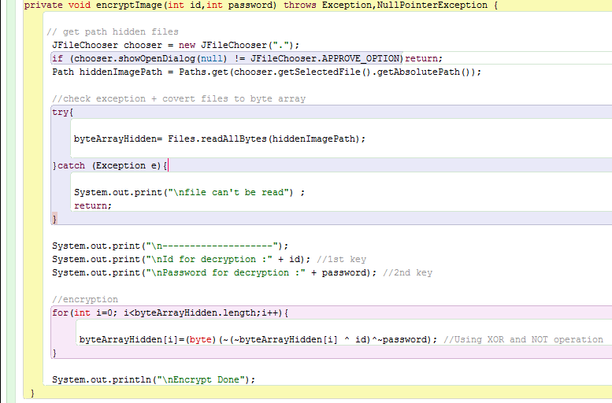
2 keys:
ID
PASSWORD
Notes:
This is my java code for the encryption. We will use 2 integer numbers as keys to encode the pictures. What is the reason for using 2 keys? It’s because of the security

Slide 9
Security
Notes:
Because I want to increase the security of the encryption to avoid some people can decode the pictures by using brute force attack. And what is Brute force attack?

Slide 10
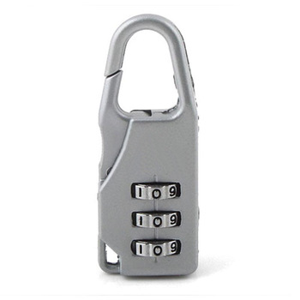
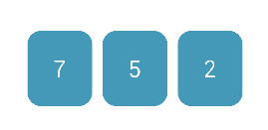
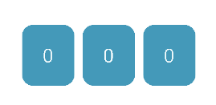

Brute Force Attack
Notes:
Let look at this numeric lock. Basically, you can open this lock by finding the correct combination . First you try the combination 0-0-0, then you try 0-0-1, then 0-0-2, and so on, until you can open it. It will take you a while to find the right combination but after all, you finally can open it. You might get lucky and find it in the first minute. We call this technique Brute Force. . So, to avoid someone can find the password, we use 2 different keys to encode the pictures.

Slide 11
2 integer keys
ID
PASSWORD
Possibilities
4294967295
4294967295
1.8x10¹⁹
X
Notes:
So, each integer key has over 4 billion possible, we have 2 keys which is 1.8x10^8

Slide 12
Hiding Picture

Slide 13
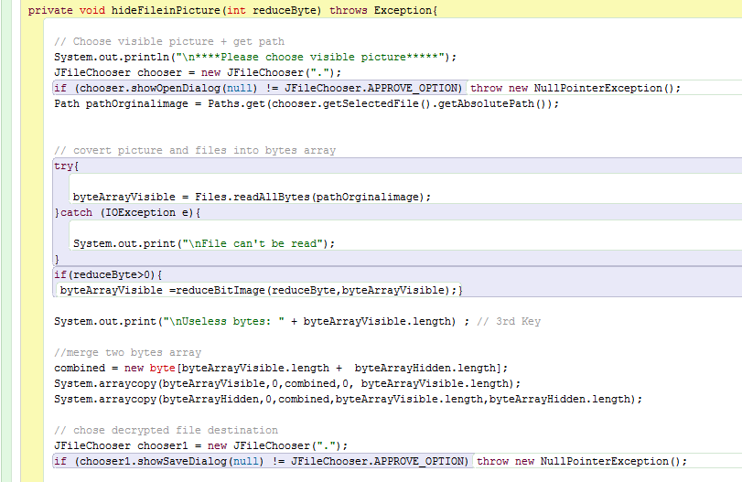
Notes:
This is the code that we developed to hide the pictures, however, instead of explain it to you one by one. Im going to show you an animation to show my program works

Slide 14


Encrypted
Steganography
Notes:
Have a look, this is the visible picture, and this is the pictures that we encoded. What we did is put the encrypted picture behind another pictures. Simple So, how exactly we can do that?

Slide 15
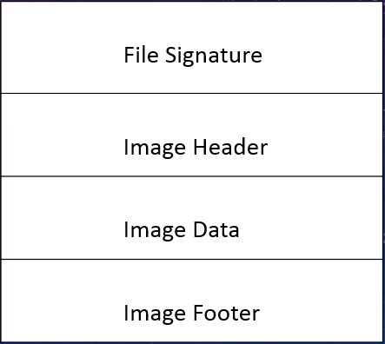
Secret Info

Slide 16
Restoring Image
Notes:
So, how can the receiver can recover the picture that we hided. To do that, im going to show you another animation.

Slide 17
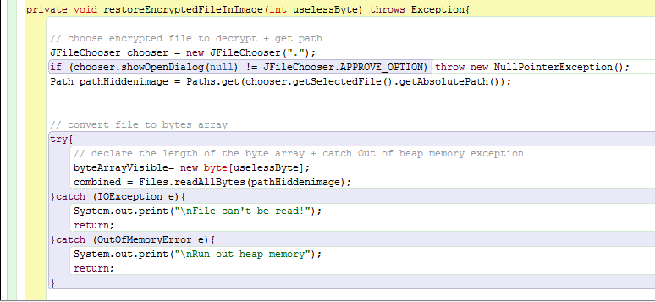
1 Key:
PICTURE LENGTH
Notes:
Again, this is the code for it. However, this times, we have 3 different keys. Why 3? I m about to explain it to you.

Slide 18
Picture length
Secret Info

Slide 19
Encrypted
Recovered
Notes:
First, we separate them into 2 different pictures. Then, we don’t need the cover picture anymore, so just remove it; what we have left is the picture we hided before.

Slide 20
Decryption
Notes:
After we take the information out. The last step is to decrypted it.

Slide 21
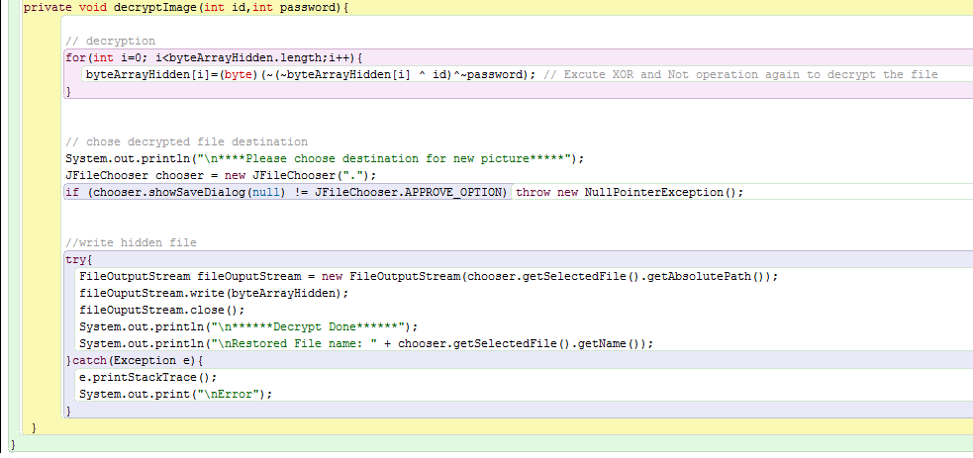
2 keys:
ID
PASSWORD

Slide 22
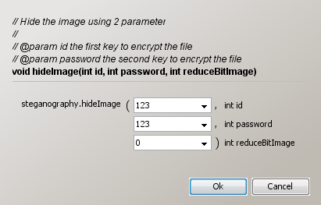
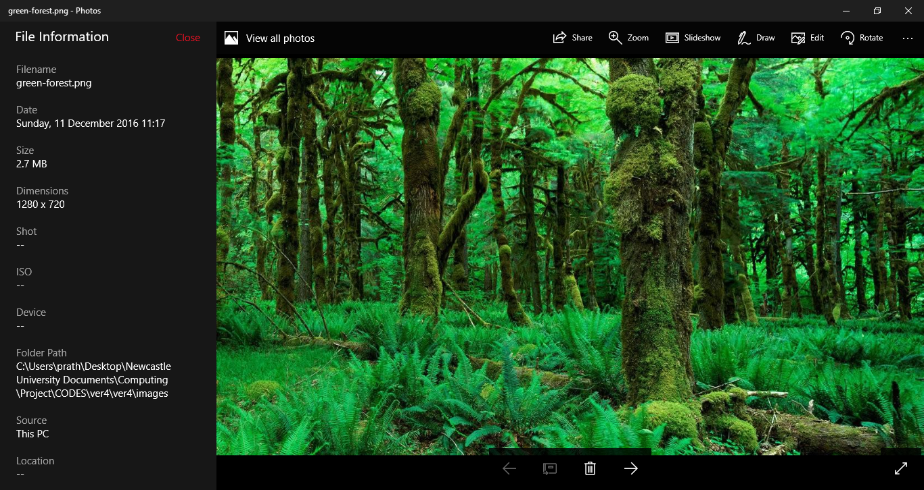

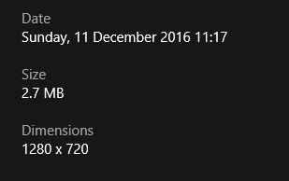
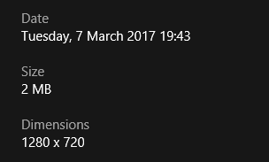
Least significant bit
Picture Size Manipulation
Notes:
Evidence- Picture Size- Reduce unimportant information

Slide 23
Unexpected
Failed Encryption
Universal Code
All-round solution
Without compressing (zip)
Picture
Text
Sound
Video
Except .exe
Compressed
Any file (Literally)
Notes:
Reduce or Not
In version 2, If the id and password is the same it will still hide the picture but it won encrypt.
Because of failed algorithm id ~password
NOT operation

Slide 24
Live Demonstration

Slide 25
Application

Slide 26
Improvements
More secured encryption method
Choosing pictures (HD)
Notes:
A more complicated algorithm can be used to ensure a higher detailed encryption can be done and it also improves security by increasing time it takes for encryption.
We could use a high quality image like a 1080p picture or a 4K picture. A higher quality has a higher file size and a higher file size means more information is available for us to use. We can remove a lot more of the unnecessary information and replace it with the information we want to hide and since there is more information available for us to use, a lot more information can be hidden.

Slide 27
Conclusion
Notes:
So, in conclusion, we have talked about what we did in Semester 1 and Semester 2. We then showed live demonstrations using our Raspberry Pi and Java Code, We also showed real life applications of our code. Finally we talked about the results and also camp up with some solutions and improvements to our project.
Any questions?
Thank you all for your valuable time and I hope you have enjoyed our presentation.

